Slide 1

The lazy Wood gatherer
Tonka Milardović Marija Pavić Maja Vržina Nikol Martinović Niki Elezović 6.a

Slide 2
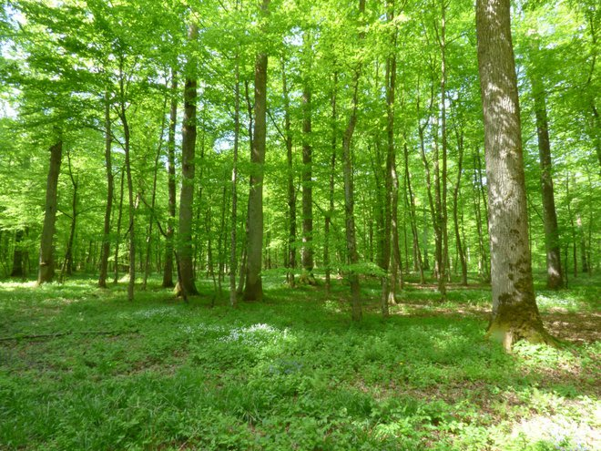
Charathers
Gabriel
Gabriel’s mother
Gabriel’s father

Slide 3
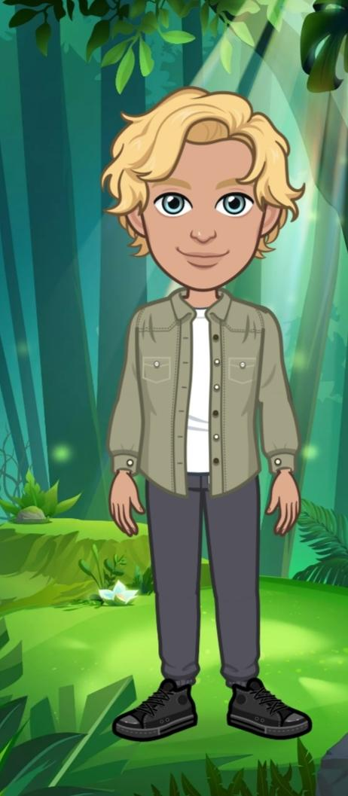
Gabriel
Gabriel is a teen boy
He is tall and slim
He has got blond curly hair
His eyes are blue
He is wearing a white T-shirt, green jacket and black pants.His shoes are black
He is sleepy and hasty

Slide 4
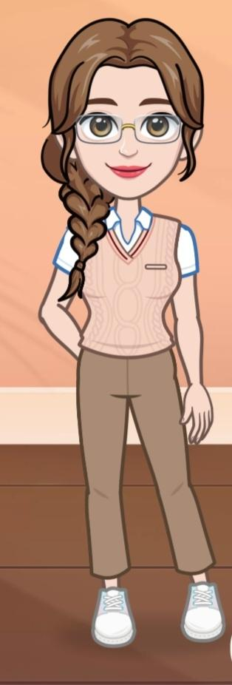
Gabriel’s mother
Gabriel’s mother is in her late fourties
She is slim and tall
She has got long brown hair made in braid
Her eyes are brown and she is waring glasses
Her lips are small and red
She is wearing a pink pullover over white shirt
and long brown pants
Her shoes are white
She is smart and friendly

Slide 5
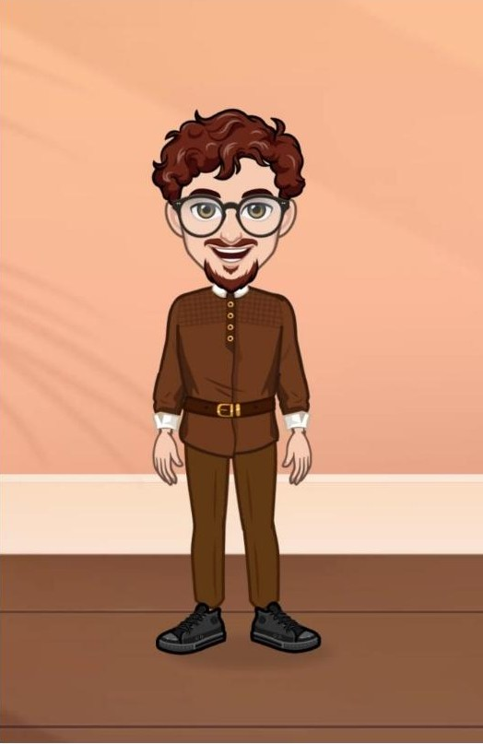
Gabriel’s father
Gabriel’s father is in his late fourties
He is tall and slim.
He has got short curly brown hair
and beard
He is wearing a brown jacket
with small brown belt,
brown pants and black shoes.
He is wearing glasses.

